Slide 1












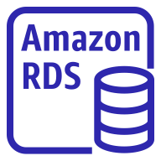
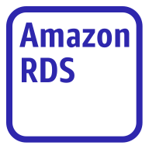
AWS Cloud
Region
Availability Zone 1
Availability Zone 2
VPC
Public subnet
Internet gateway
Public subnet
Internet
NAT gateway
Application Load Balancer
NAT gateway
Private Application subnet
Private Application subnet
Client
Application server
Application server
Users
Private Database subnet
Private Database subnet
Multi AZ (replication)
Amazon RDS instance
Amazon RDS
instance alternate

